Slide 1
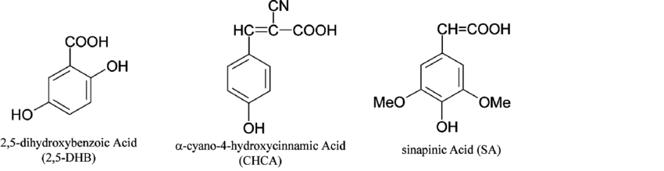
Matrix Assisted Laser Desorption/Ionization (MALDI)
Sample / Matrix
25 kV
N₂ Laser – 337 nm

Slide 2
Matrix Assisted Laser Desorption/Ionization (MALDI)
Sample / Matrix
25 kV
N₂ Laser – 337 nm

Slide 3
Matrix-Assisted Laser Desorption (MALDI) Time of Flight (TOF) Mass Spectrometry
Detector
Vacuum
337 nm N₂ UV
Laser Pulse
25 kV

Slide 4
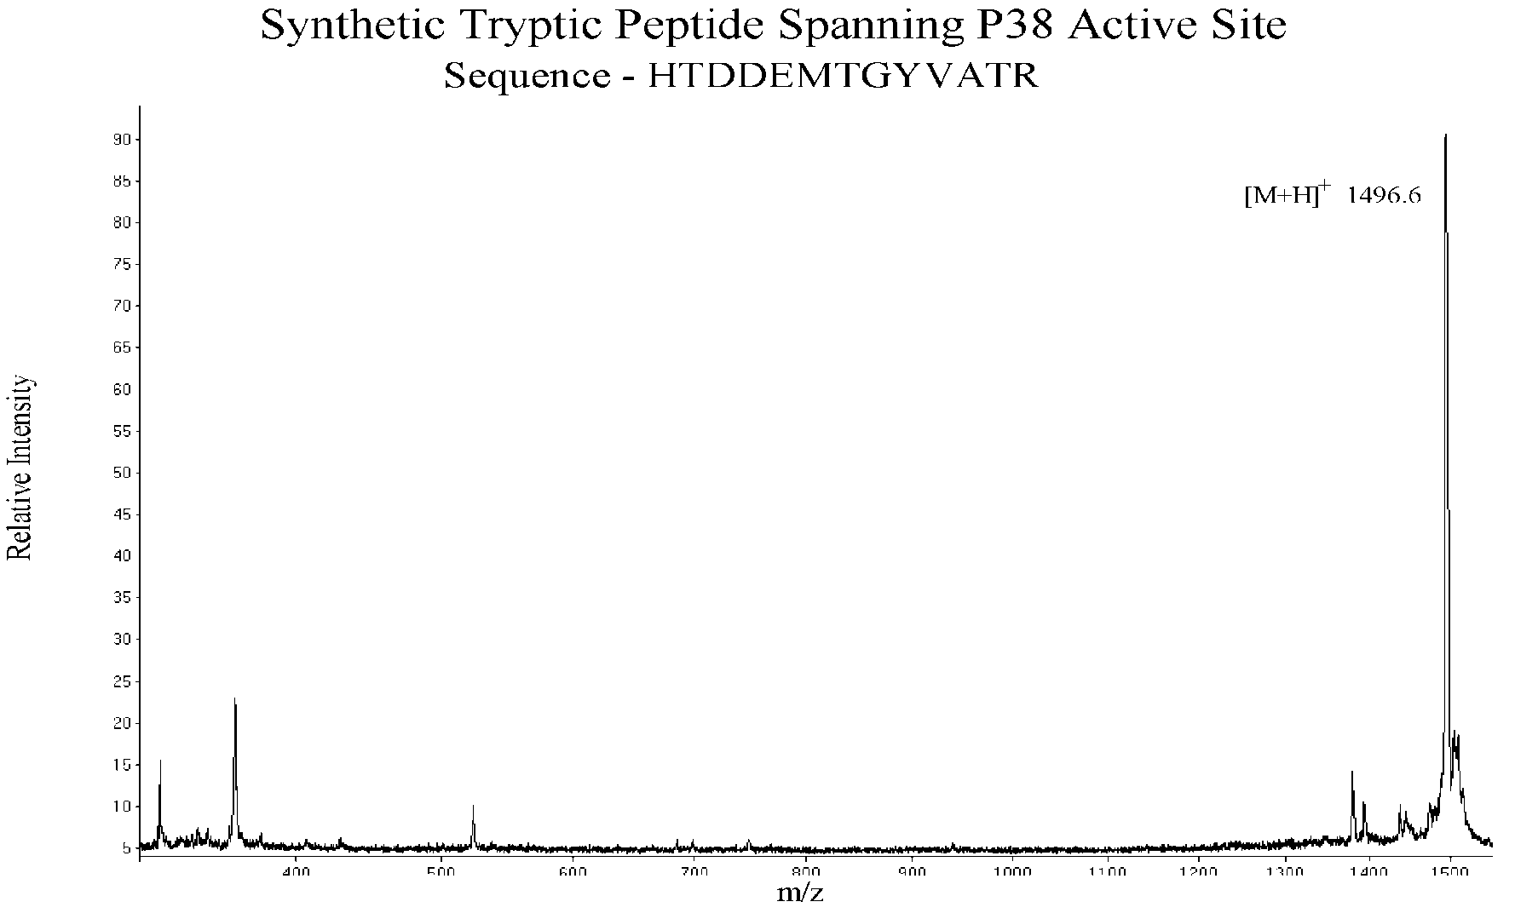

Slide 5
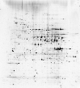
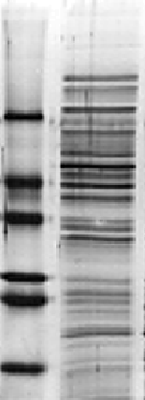
Proteomics: Traditional Technology
2D Gel
1D Gel
N
C
N
C
Characterize peptides by mass spectrometry

Slide 6
Peptide Mass Fingerprinting
(1) Digest
protein
(2) Time of Flight
MALDI
Detector
…R ASDEWK LHPSR WEQCPEFGR…
(3) Set up
mass list
609
735
1152
…
(4) Compare mass list against protein database of peptides

Slide 7
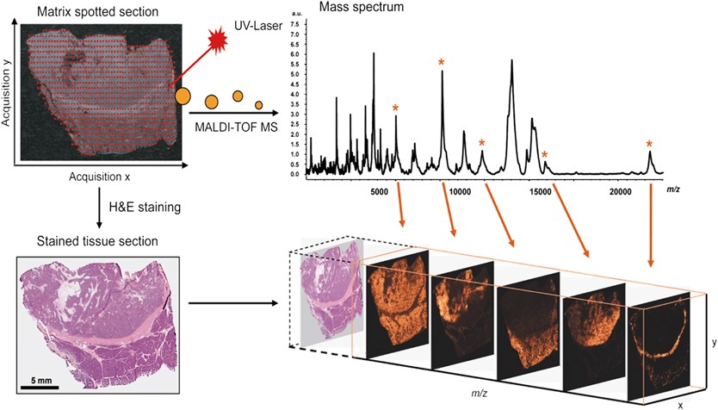
MALDI-TOF is used for imaging

Slide 8
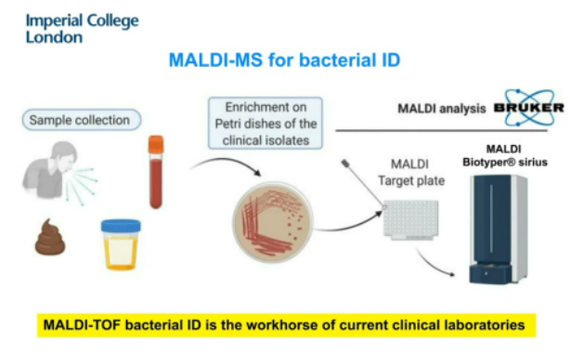

Slide 9

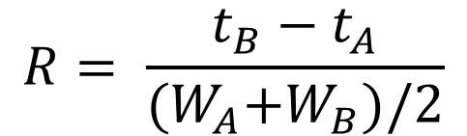
Resolving power in Mass Spectrometry
In Chromatography
In Mass Spectrometry
$$R= \frac{t_{B}−t_{A}}{{(W}_{A}+W_{B})/2}$$
$$R=\frac{m}{∆m}$$
depends on the mass
Quadrupole and Quadrupole Ion Traps: Delta Mass is constant across mass range. So R increases with m/z normally report just delta mass
Time of Flight: Resolving power is constant across mass range. So, the delta mass increases with m/z
Orbitrap Mass Analyzer: Resolving power decreases by the square-root of m/z
Ion Cyclotron Resonance Mass Analyzer (FTICR): Resolving power is inversely proportional to m/z

Slide 10
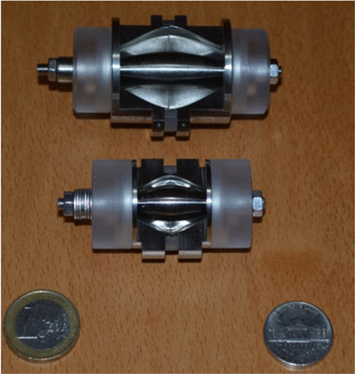
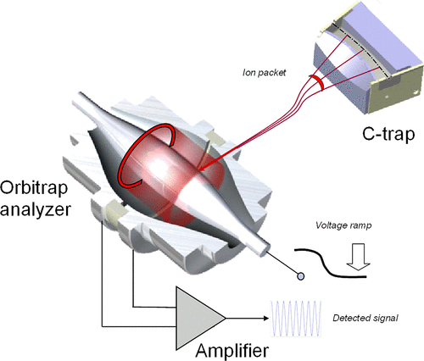
Orbitrap Mass Spectrometer

Slide 11
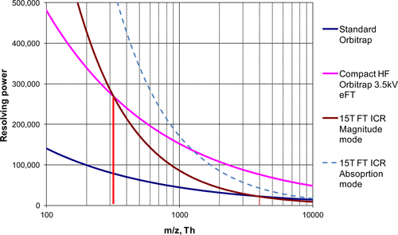
m/z Dependency of Resolving Power
Zubarev and Makarov, Anal Chem 2013

Slide 12
pI
Mr
excision/digestion
LC-MS/MS

Slide 13
Shotgun Proteomics
Protein Mixture
MS/MS
1
2
3
3
proteolysis
2
µLC
MS
1
Peptide Mixture

Slide 14
Data Dependant Acquisition
No
Yes
Is Intensity > Threshold
Is Ion Present In Mass List
Full Scan 400-2000 m/z
Yes
No
Isolate m/z and Acquire MS/MS
Add Mass to Mass List
Yates et al. Anal Chem, 67, 1426 (1995)
Stahl et al. JASMS, 7, 532 (1996)

Slide 15

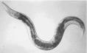
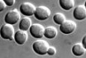
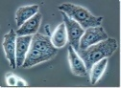
Can we perform this experiment without the separation of proteins?
Extract Protein Mixture
Model Organisms
cells in culture
Denature
Digest into Small Pieces

Slide 16
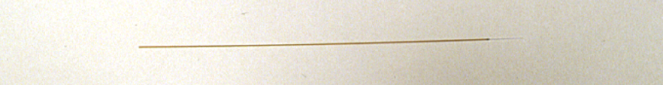
Measurement of Peptides by Microcapillary Liquid Chromatography Tandem Mass Spectrometry
Microcapillary Chromatography Column
Peptide Mixture
Peptides are loaded onto the column and separated by liquid chromatography
Abundance
Time

Slide 17
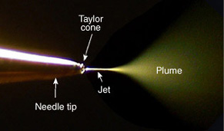
Acquiring Mass Spectrometry Data of Peptides
Microcapillary Column
2 kV
30 V
Peptides from the column are ionized and transmitted into the vacuum system using electrospray and trapped in the 2-dimensional ion trap

Slide 18
Acquiring Mass Spectrometry Data of Peptides
Peptides from the column are ionized and transmitted into the vacuum system using electrospray and trapped in the 2-dimensional ion trap
Ions are selectively ejected radially by their m/z to produce a mass spectrum
The instrument data-system automatically selects a m/z for further analysis
Selected m/z
Abundance
m/z

Slide 19
Acquiring a Fragmentation Spectrum
The trap is then refilled

Slide 20
Acquiring a Fragmentation Spectrum
The trap is then refilled
All ions are ejected from the trap except the predetermined m/z
The energy of the isolated ion is increased resulting in collisions with the helium gas in the trap

Slide 21
Acquiring a Fragmentation Spectrum
The collisions with the helium molecules result in structure specific fragment ions
The fragment ions are then selectively ejected to produce a tandem mass spectrum
Abundance
m/z

Slide 22
Review
Mass Spectrum
1
2
3
Tandem Mass Spectra of Peptides
~1 Second per cycle
Acquire mass spectrum
Select peptides for tandem mass spectrometry
Selectively isolate and fragment peptides.
Repeat for 3 different peptides

Slide 23
S Q H L F A P I S E K
Notes:
How do we derive a peptide sequence from it’s MS/MS spectrum. Predominantly amino acids are fragmented at amide bonds and because amino acids have different side chains we can the amino acid sequence from the difference in mass in adjacent fragments.

Slide 24
88
216
353
467
614
685
782
895
982
1111
S Q H L F A P I S E K
1170
1042
905
792
645
574
477
363
276
147
1042 / 2
792
M-NH₃
905
574
644
467
685
1042
353
895
1111
982
Notes:
When you look at all the spectra data together you can deduce the sequence of this peptide ion. You can see in red the masses of the peptides fragmented between the Leu and Phe residues.

Slide 25
Automated Interpretation of MS/MS Spectra
MS/MS Spectrum
Cross Correlation (Sequest)
Theoretical MS/MS Spectra
Search Database for Precursor Mass
HTTLDEM
DTTEMIH
TMETIDH
Automated
Sequence and
Modification Identification
Eng et al. JASMS, 5, 976 (1994)

Slide 26
Spectrum Identification
SEQUEST
Peptide ID list
Scan1 0.7 EGSSDEEVP…
Scan1 0.3 TFAEILNPI…
Scan1 0.2 ARFDLNNHD…
-------------------
Scan2 0.5 EDEESIRAV…
Scan2 0.2 WLGDDCFMV…
Scan2 0.1 IDRAAWKAV…
-------------------
Scan3 0.2 EITTRDMGN…
Scan3 0.1 GRNMCTAKL…
MS/MS spectra
…
Computer Cluster
>MEKK1 (kinase)
MDRILARMKKSTRRGGDKNITPVRRLERR…
>ATMKK5 (kinase kinase)
MKPIQSPSGVASPMKNRLRKRPDLSPPLPHRDVALAVLP…
ID proteins from peptides…
Database: fasta file
Eng et al. JASMS, 5, 976 (1994)

Slide 27
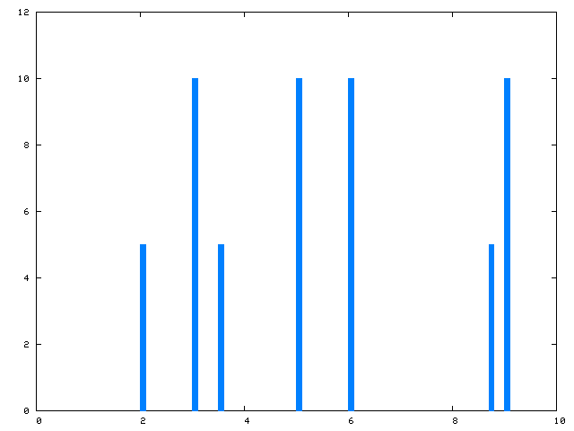
Spectrum Identification
SEQUEST
Peptide ID list
Scan1 0.7 EGSSDEEVP…
Scan1 0.3 TFAEILNPI…
Scan1 0.2 ARFDLNNHD…
-------------------
Scan2 0.5 EDEESIRAV…
Scan2 0.2 WLGDDCFMV…
Scan2 0.1 IDRAAWKAV…
-------------------
Scan3 0.2 EITTRDMGN…
Scan3 0.1 GRNMCTAKL…
z = 2, m/z = 720.6
mass = 1441.2
MS/MS spectra
score = 0.3
>MEKK1 (kinase)
MDRILARMKKSTRRGGDKNITPVRRLERR…
>ATMKK5 (kinase kinase)
MKPIQTFAEILNPITWRNRLRKRPDLSPPLPHRDVALAVP…
TFAEILNPITWR
Database: fasta file
Eng et al. JASMS, 5, 976 (1994)

Slide 28
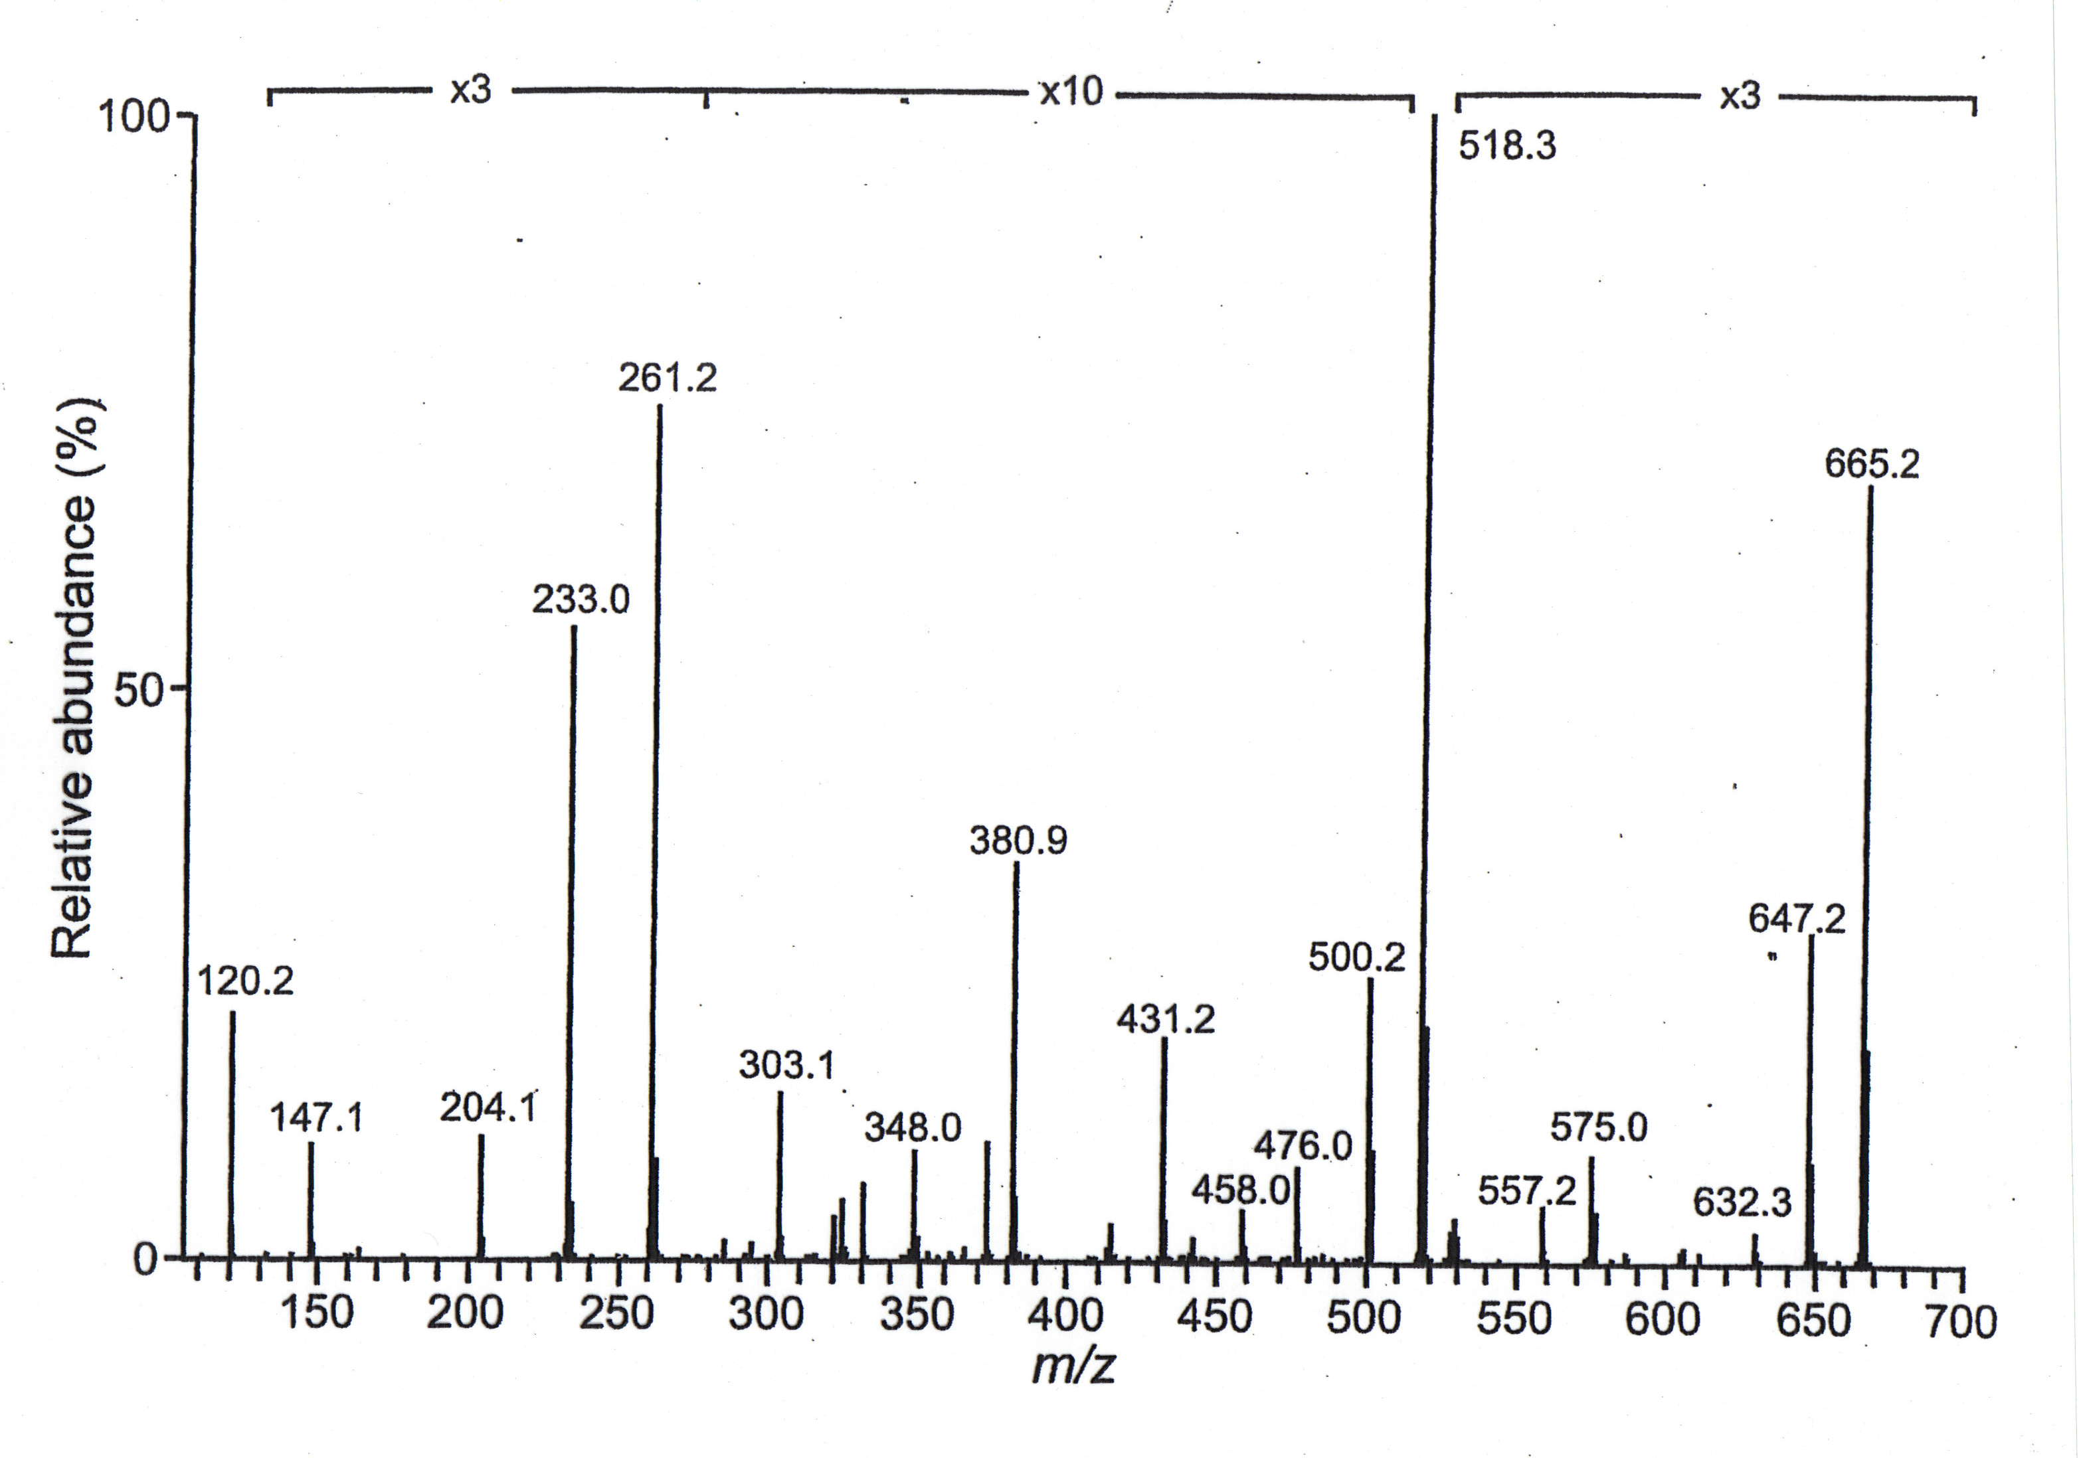
[M+H]⁺ = 778.6

Slide 29
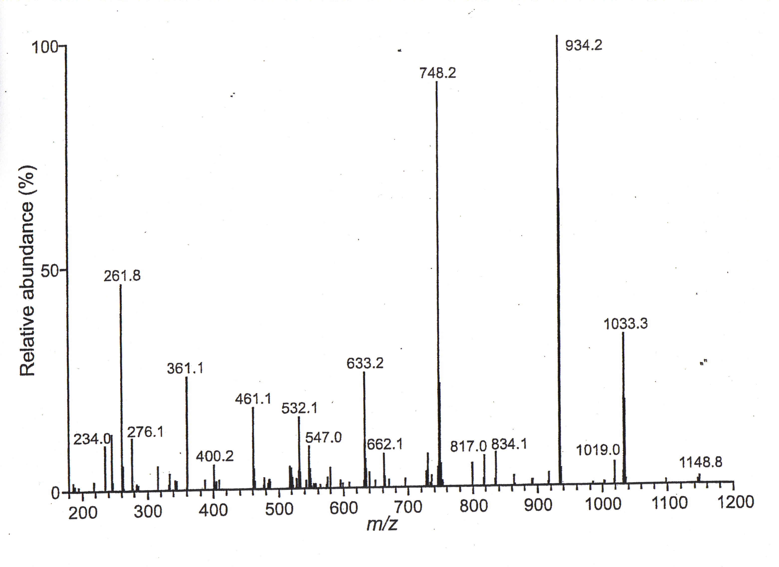
[M+H]⁺ = 1295.0

Slide 30
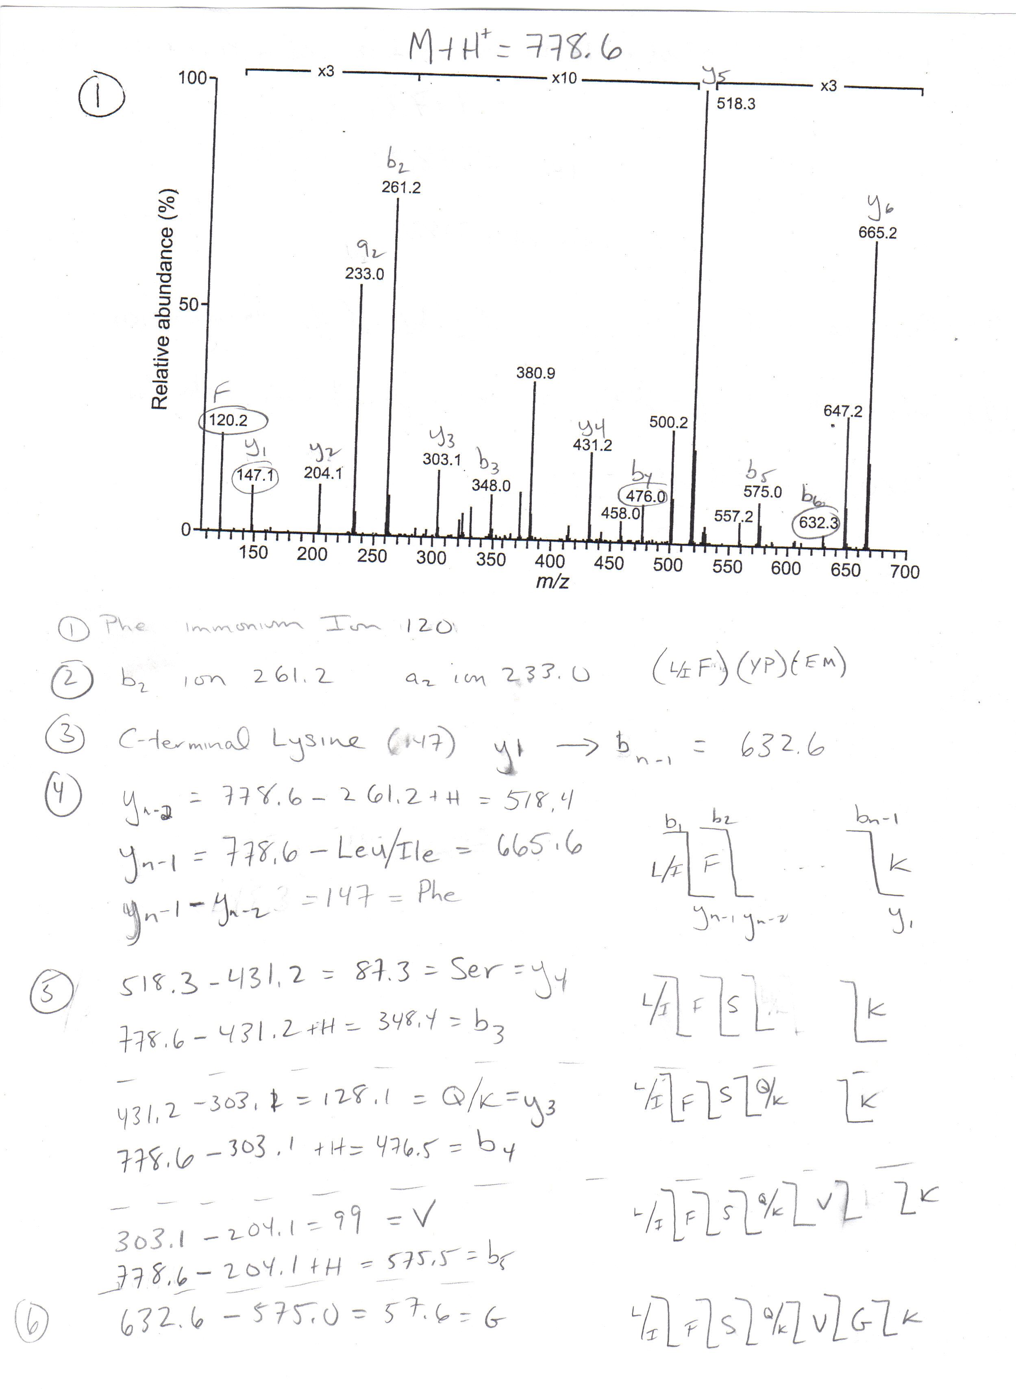
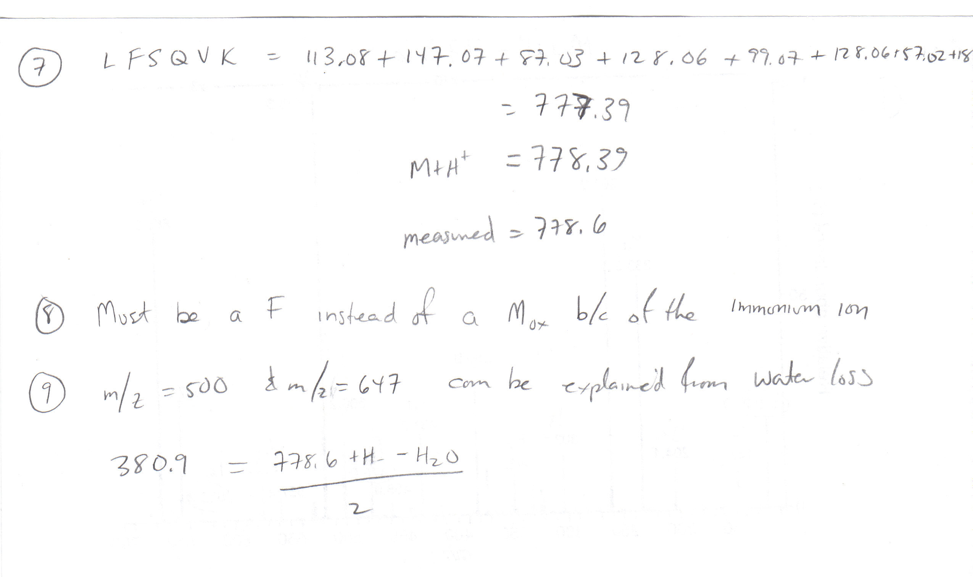

Slide 31
